Slide 1
SnapDragon
T.Dharani (1818113)
K.Sowndarya(1818153)

Slide 2
Exp no:9 Implementation of HTTP Socket
AIM :
To write a Python program to implement
HTTP Socket.

Slide 3
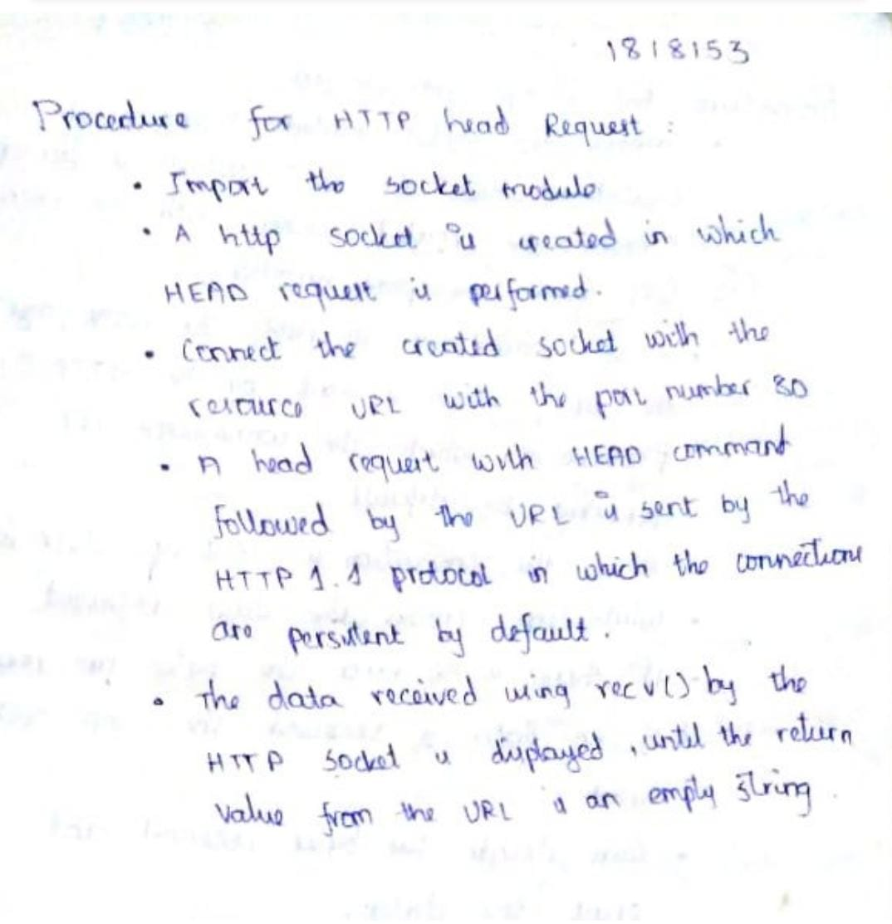
Procedure:

Slide 4
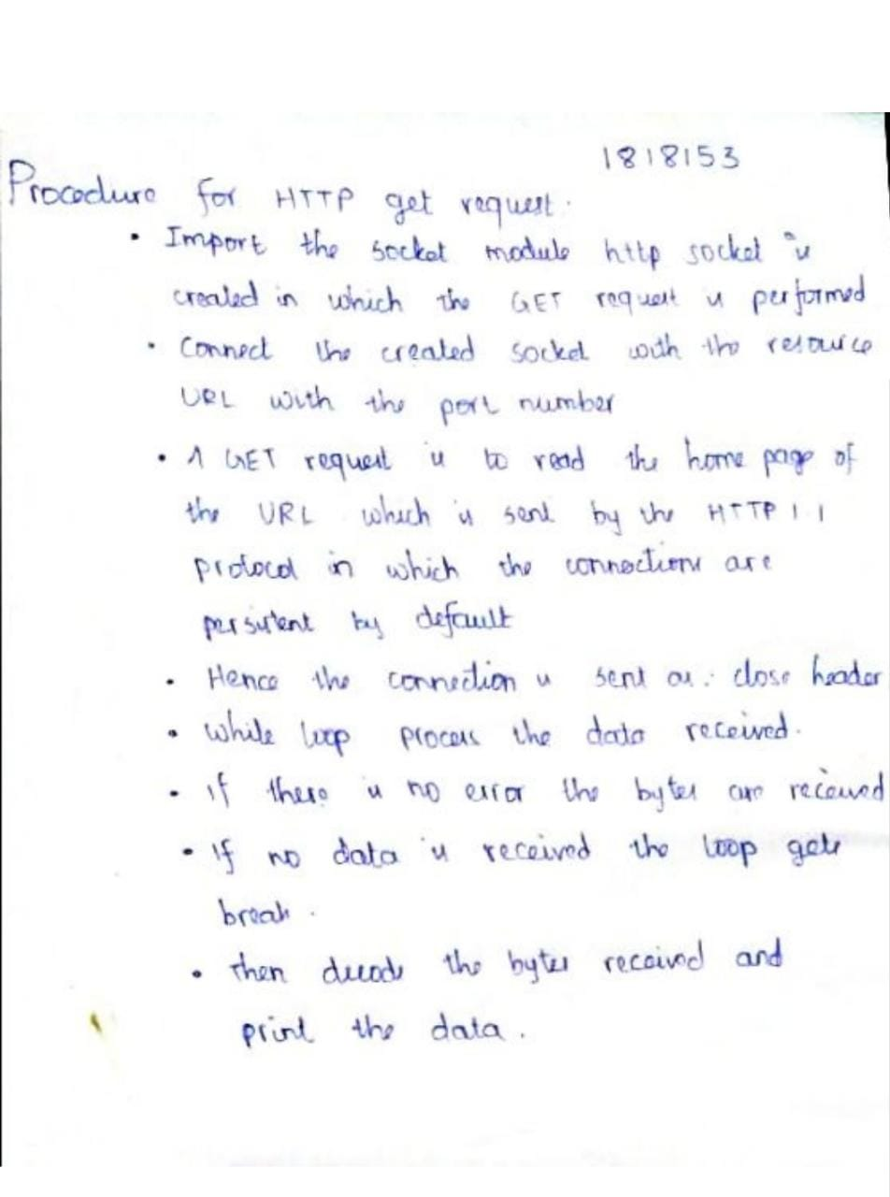

Slide 5
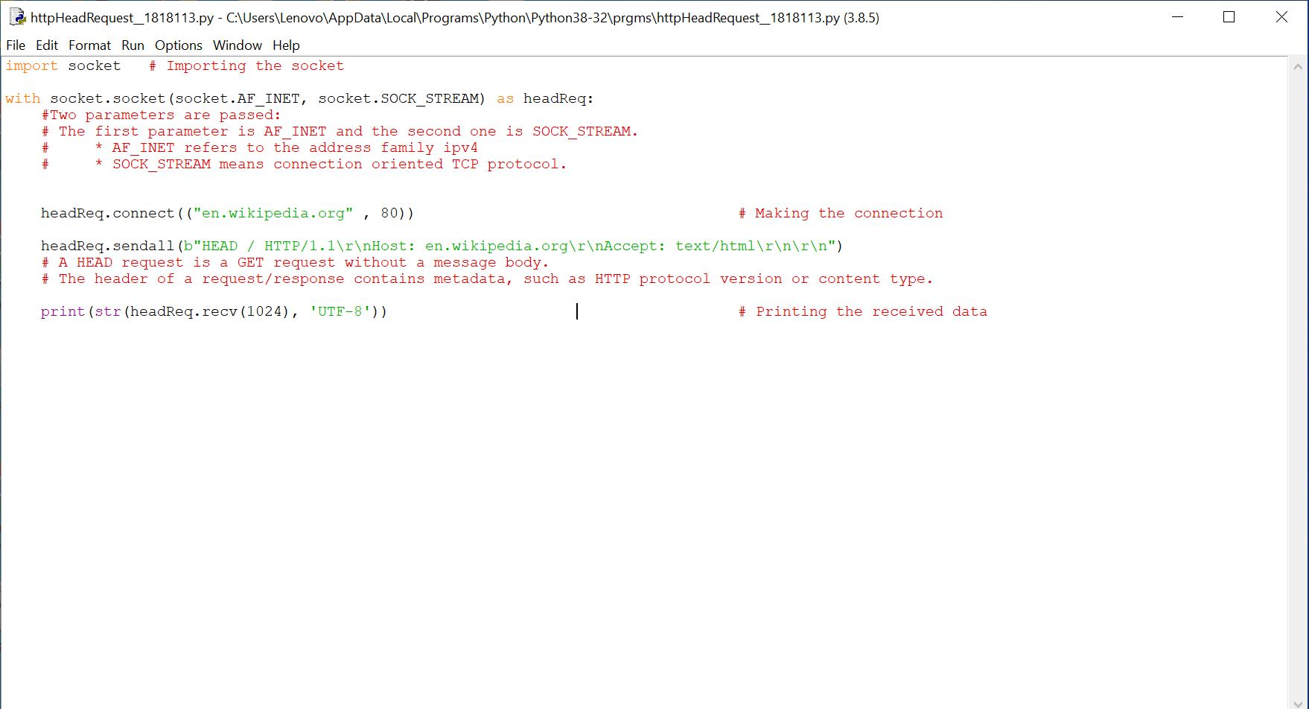
Head Request Program:

Slide 6
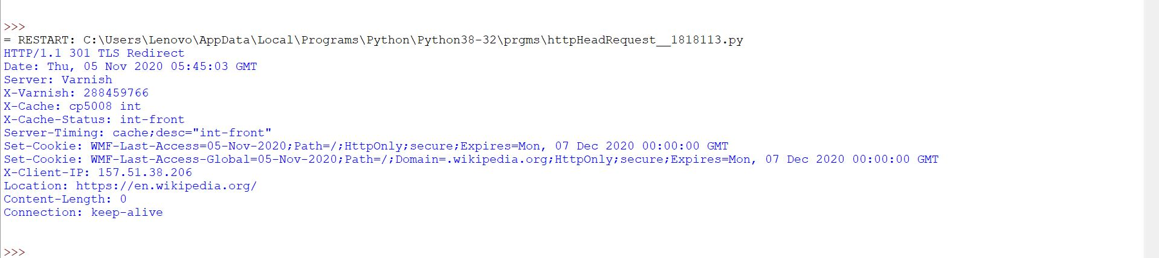
Output:

Slide 7
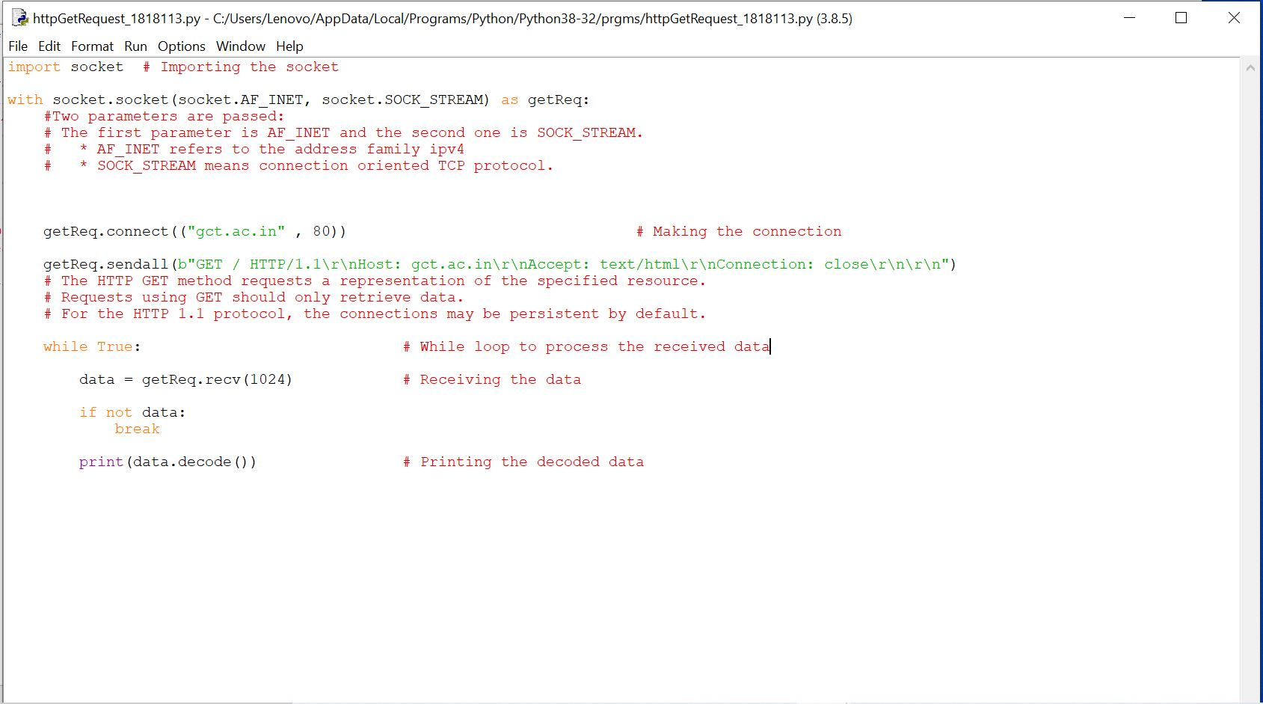
Get Request Program:

Slide 8
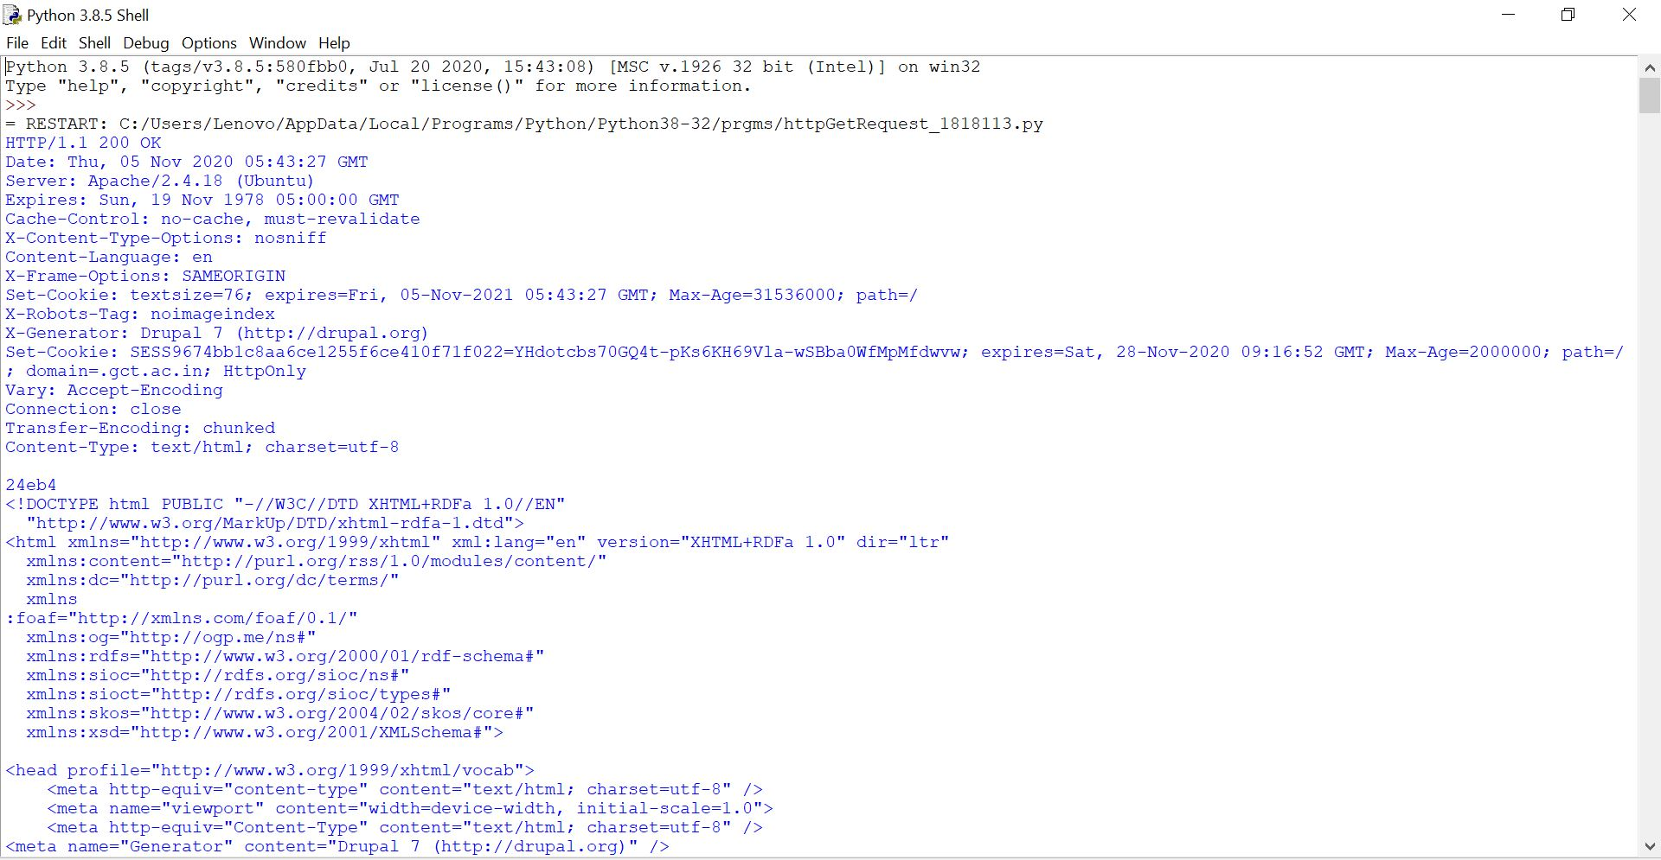
Output:

Slide 9
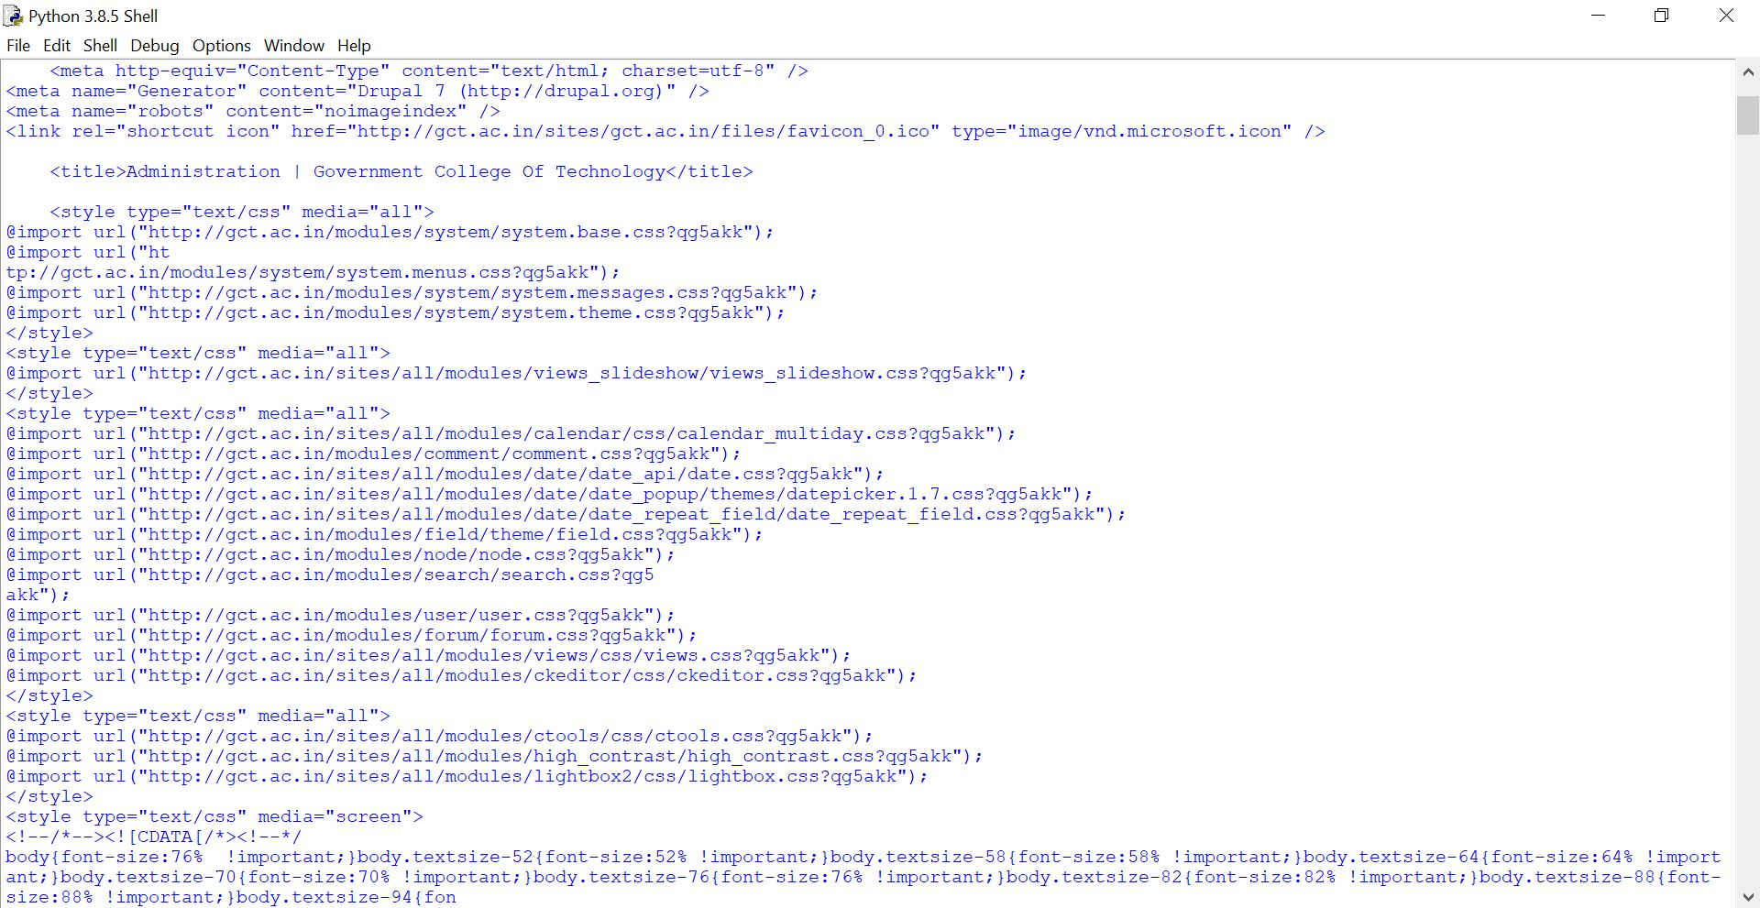

Slide 10
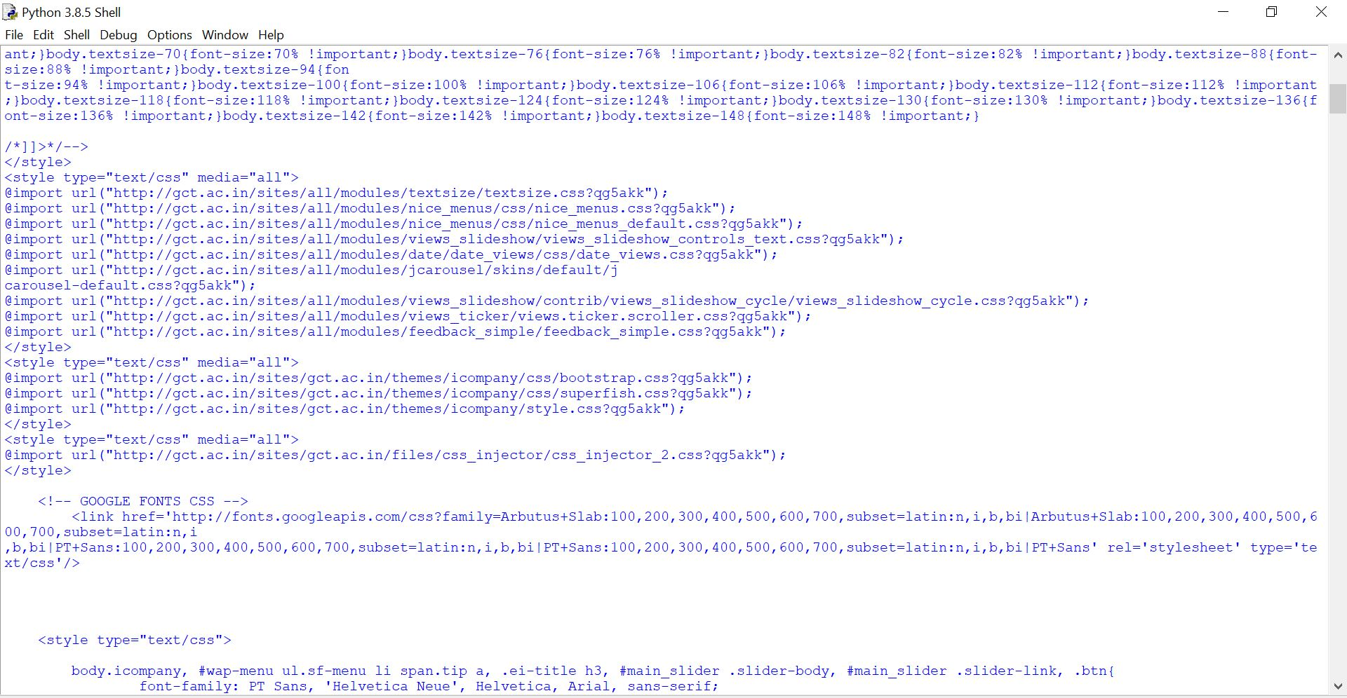

Slide 11
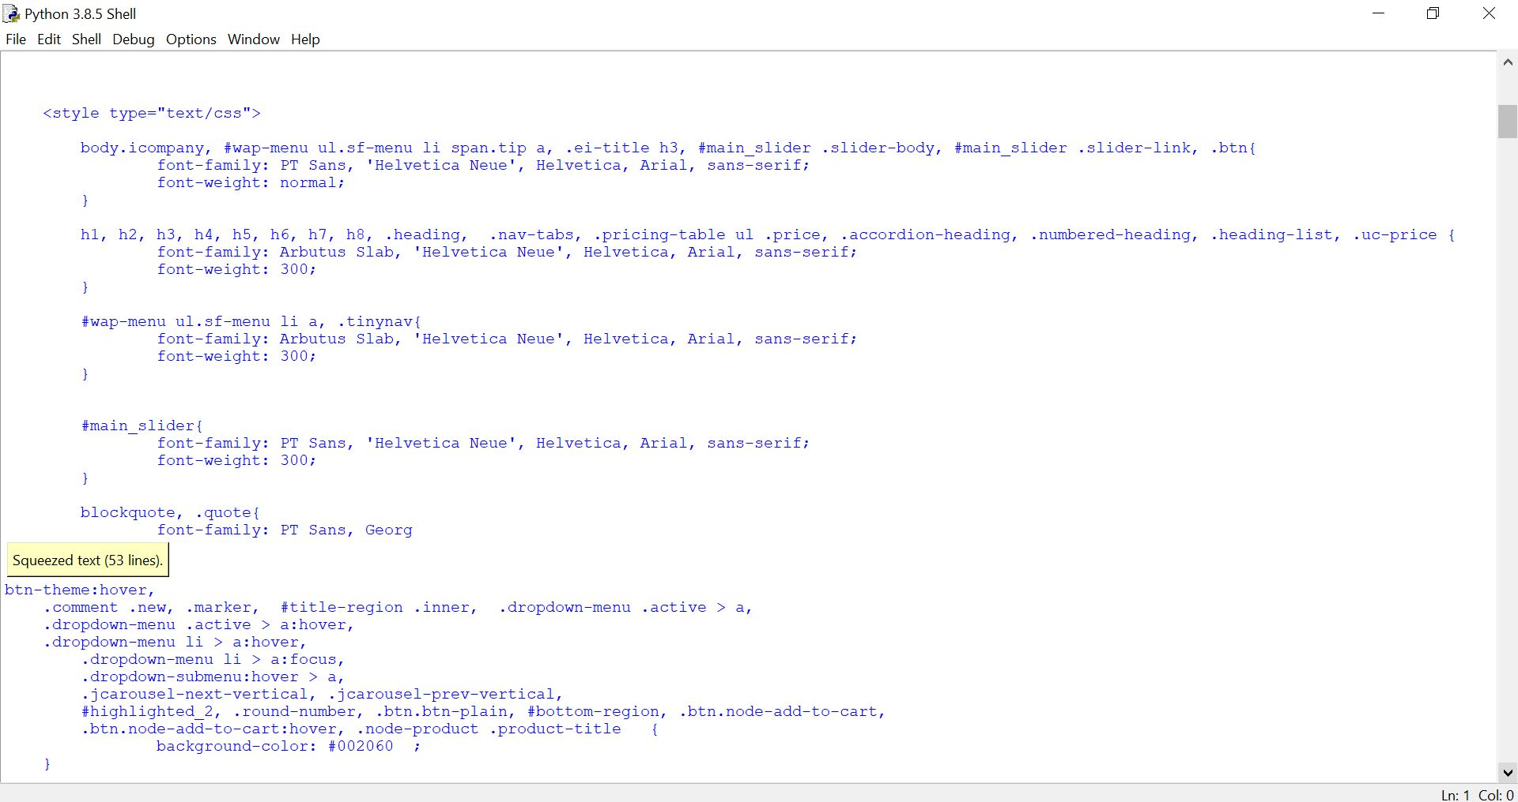

Slide 12
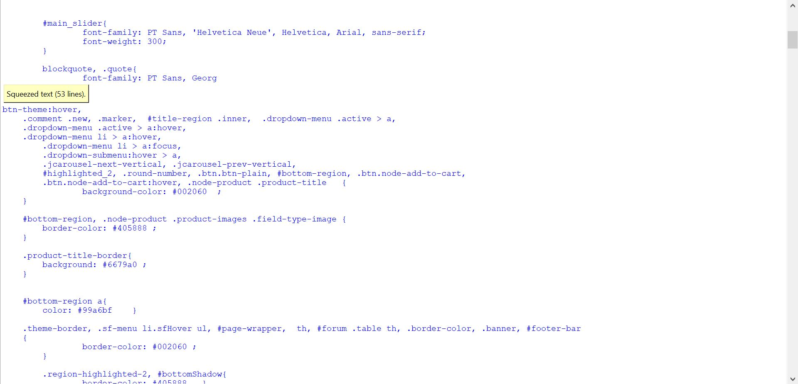

Slide 13
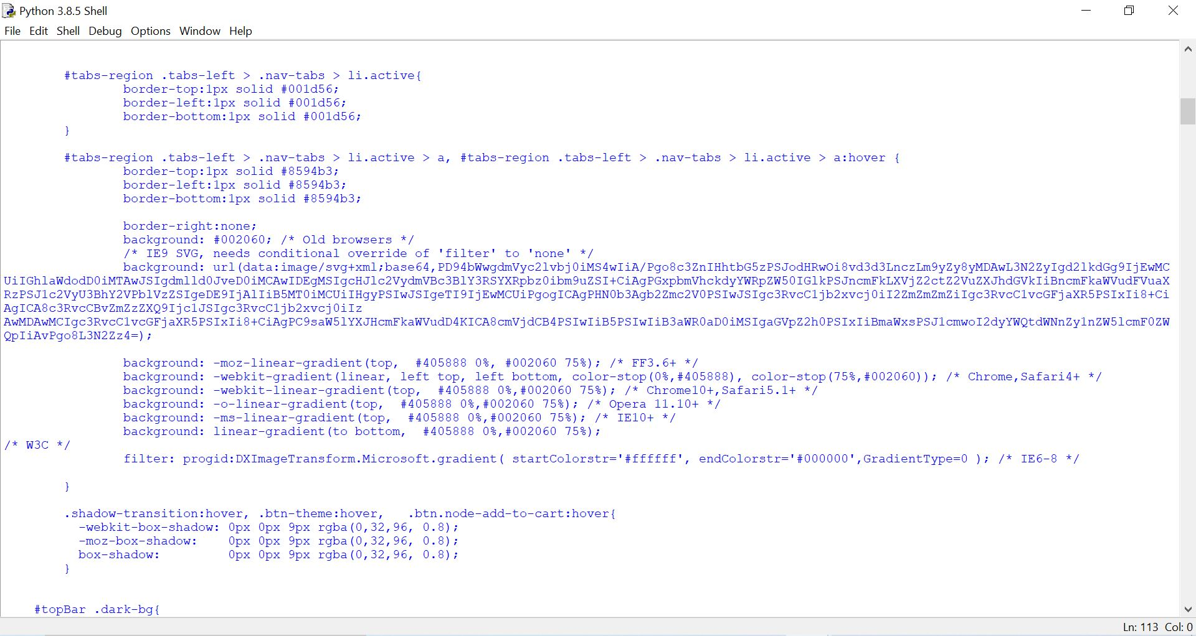

Slide 14
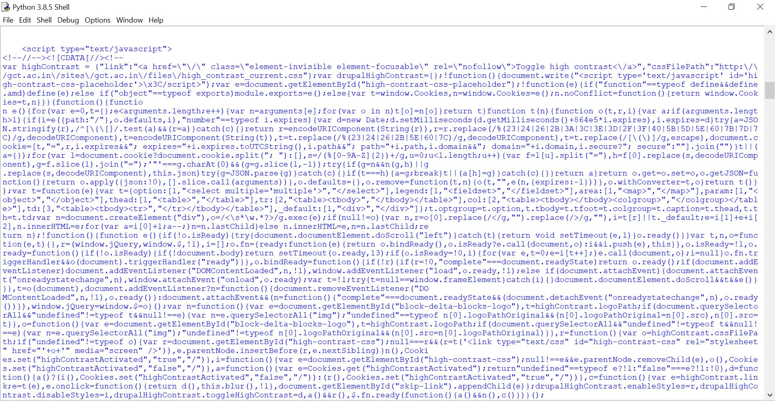

Slide 15
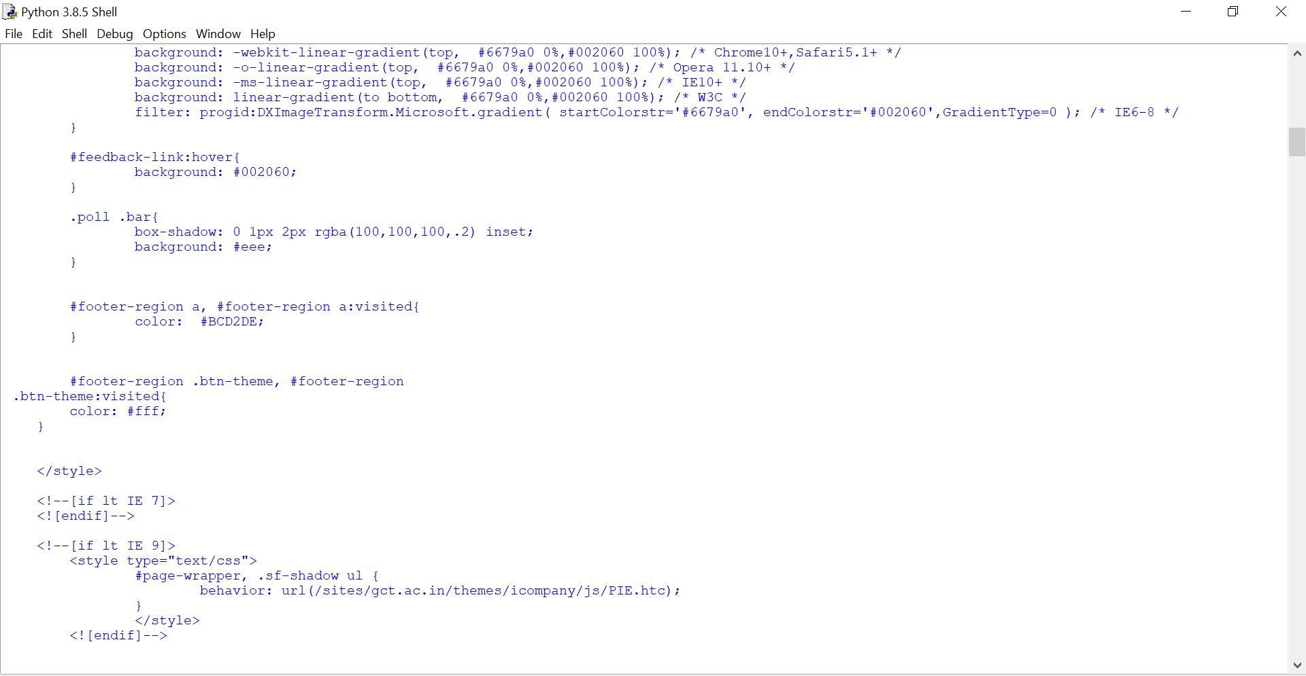

Slide 16
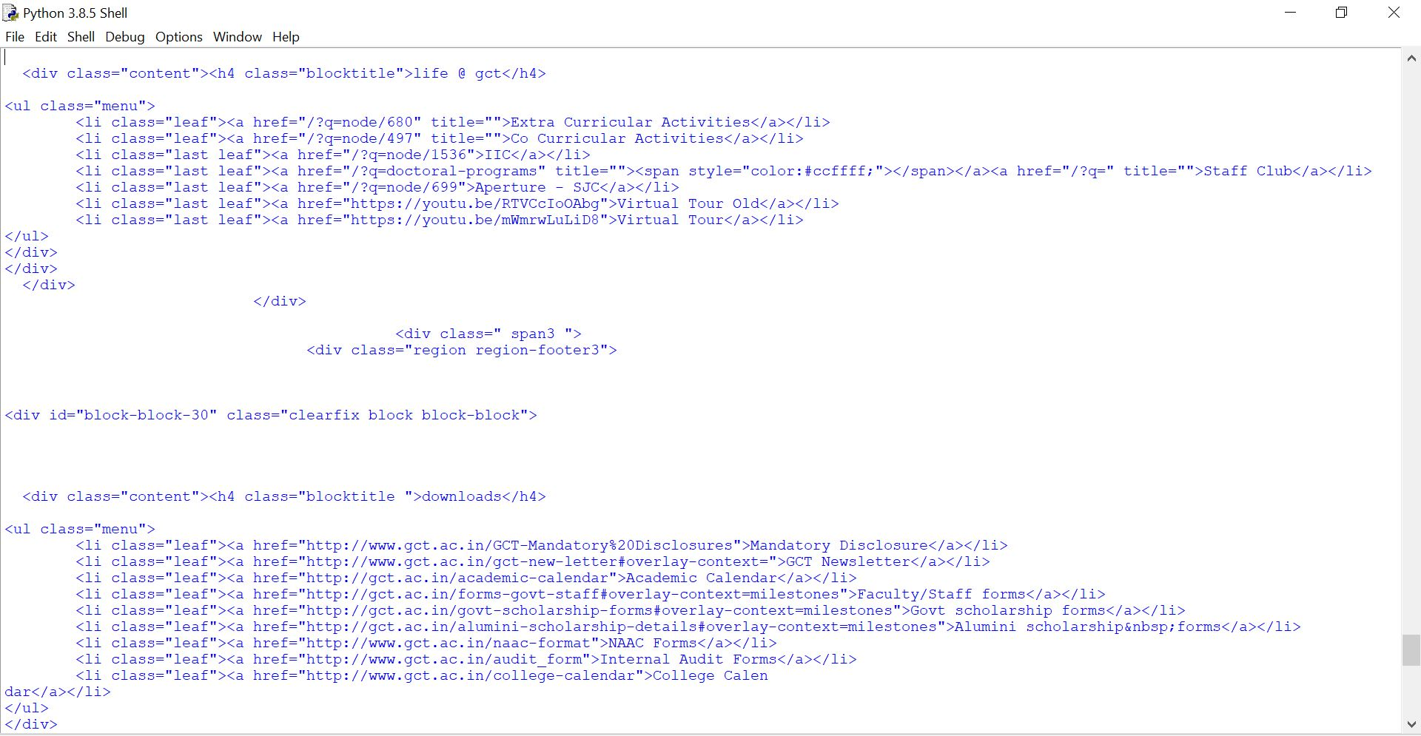

Slide 17
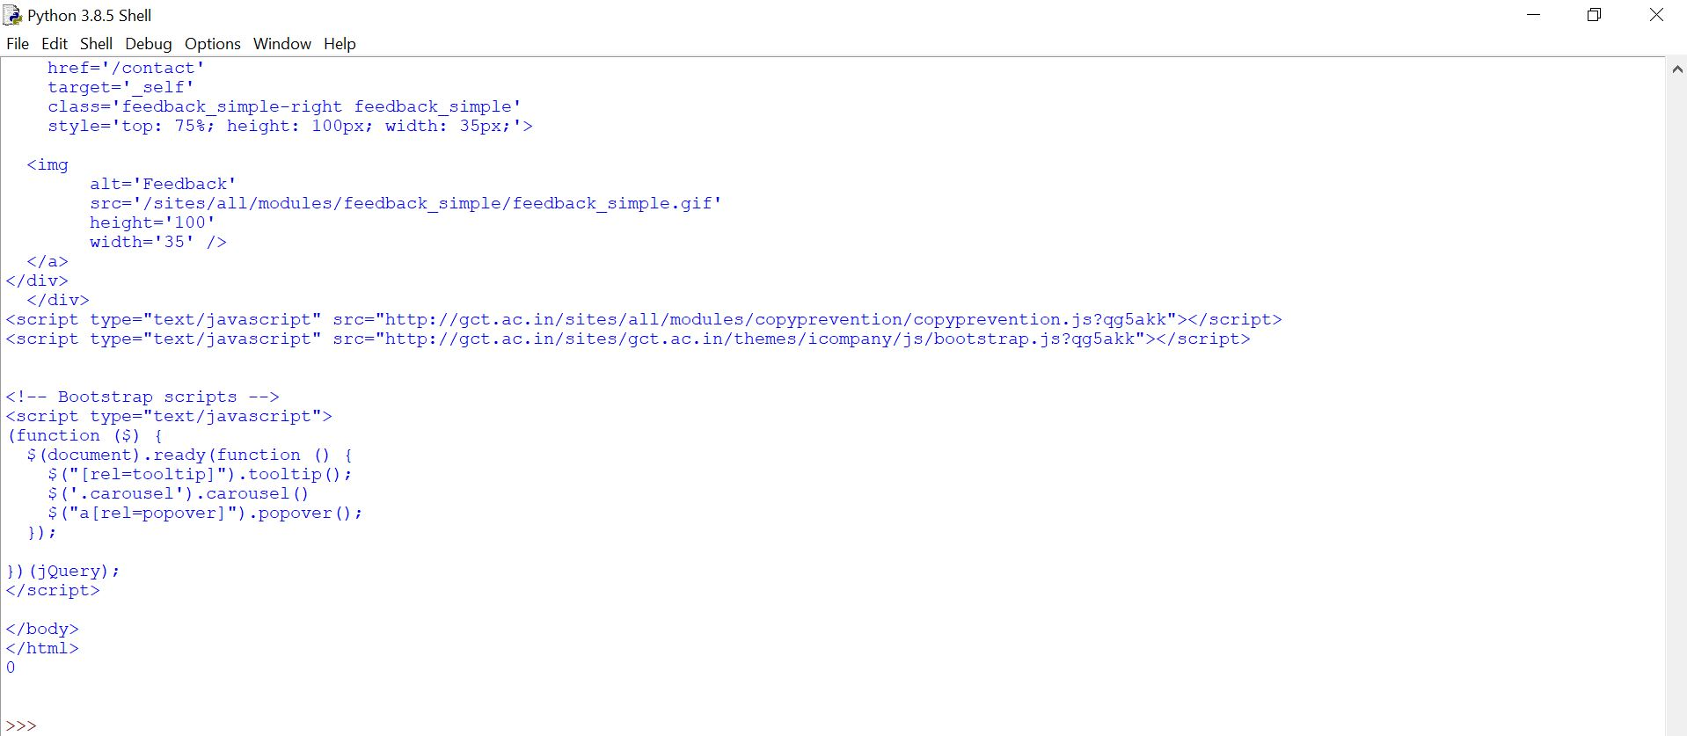

Slide 18
RESULT:
Thus, the python program to implement HTTP
Socket was executed successfully.

